Slide 1
Chapter 9: Advanced Array Concepts

Slide 2
Objectives
Sort array elements using the bubble sort algorithm
Sort array elements using the insertion sort algorithm
Use two-dimensional and other multidimensional arrays
Use the Arrays class
Use the ArrayList class
Create enumerations
Java Programming, Seventh Edition

Slide 3
Sorting Array Elements Using the Bubble Sort Algorithm
Sorting
  The process of arranging a series of objects in some logical order
Ascending order
  Begin with the object that has the lowest value
Descending order
  Begin with the object that has the largest value
Java Programming, Seventh Edition

Slide 4
Sorting Array Elements Using the Bubble Sort Algorithm (cont’d.)
Simplest possible sort
  Involves two values that are out of order
  Swap two values
  temp = valA; // 16 goes to temp
  valA = valB; // 2 goes to valA
  valB = temp; // 16 goes to valB
Java Programming, Seventh Edition

Slide 5
Using the Bubble Sort Algorithm
Bubble sort
  You continue to compare pairs of items, swapping them if they are out of order
  The smallest items “bubble” to the top of the list, eventually creating a sorted list
Java Programming, Seventh Edition

Slide 6
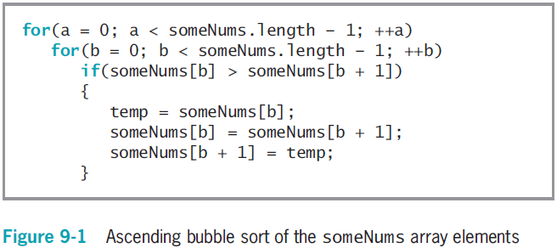
Using the Bubble Sort Algorithm (cont’d.)
Java Programming, Seventh Edition

Slide 7
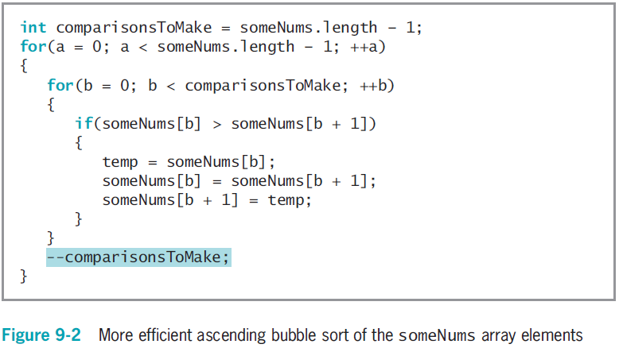
Using the Bubble Sort Algorithm (cont’d.)
Java Programming, Seventh Edition

Slide 8
Sorting Arrays of Objects
You can sort arrays of objects in much the same way that you sort arrays of primitive types
  Major difference
    Make the comparison that determines whether to swap two array elements
    Sort based on a particular object field
Java Programming, Seventh Edition

Slide 9
Sorting Array Elements Using the Insertion Sort Algorithm
Insertion sort
  A sorting algorithm that enables you to look at each list element one at a time
  Move items down if the tested element should be inserted prior to other elements
Similar to the technique that sorts a group of objects manually
Java Programming, Seventh Edition

Slide 10
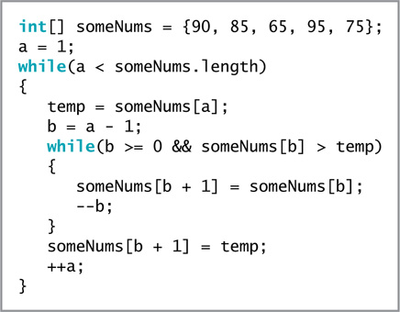
Sorting Array Elements Using the Insertion Sort Algorithm (cont’d.)
Figure 9-6 The insertion sort
Java Programming, Seventh Edition

Slide 11
Using Two-Dimensional and Other Multidimensional Arrays
One-dimensional or single-dimensional array
  An array that you can picture as a column of values
  Elements are accessed using a single subscript
Two-dimensional arrays
  Have two or more columns of values
  Have rows and columns
  Use two subscripts
  Are often called a matrix or table
  int[][] someNumbers = new int[3][4];
Java Programming, Seventh Edition

Slide 12
Using Two-Dimensional and Other Multidimensional Arrays (cont’d.)
Figure 9-9 View of a two-dimensional array in memory
Java Programming, Seventh Edition

Slide 13
Using Two-Dimensional and Other Multidimensional Arrays (cont’d.)
int[][] rents = { {400, 450, 510},
  {500, 560, 630},
  {625, 676, 740},
  {1000, 1250, 1600} };
Java Programming, Seventh Edition

Slide 14
Passing a Two-Dimensional Array to a Method
Pass the array name just as you do with a one-dimensional array
  public static void displayScores(int[][]scoresArray)
Java Programming, Seventh Edition

Slide 15
Using the length Field with a Two-Dimensional Array
The length field holds the number of rows in the array
  rents.length
Each row has a length field that holds the number of columns in the row
  rents[1].length
Java Programming, Seventh Edition

Slide 16
Understanding Ragged Arrays
Ragged array
  A two-dimensional array with rows of different lengths
To create a ragged array:
  Define the number of rows for a two-dimensional array
  Do not define the number of columns in the rows
  Then declare the individual rows
Java Programming, Seventh Edition

Slide 17
Using Other Multidimensional Arrays
Multidimensional arrays
  Arrays with more than one dimension
Create arrays of any size
  Keep track of the order of variables needed as subscripts
  Don’t exhaust your computer’s memory
Java Programming, Seventh Edition

Slide 18
Using the Arrays Class
Arrays class
  Contains many useful methods for manipulating arrays
  static methods
    Use them with the class name without instantiating an Arrays object
  binarySearch() method
    A convenient way to search through sorted lists of values of various data types
    The list must be in order
Java Programming, Seventh Edition

Slide 19
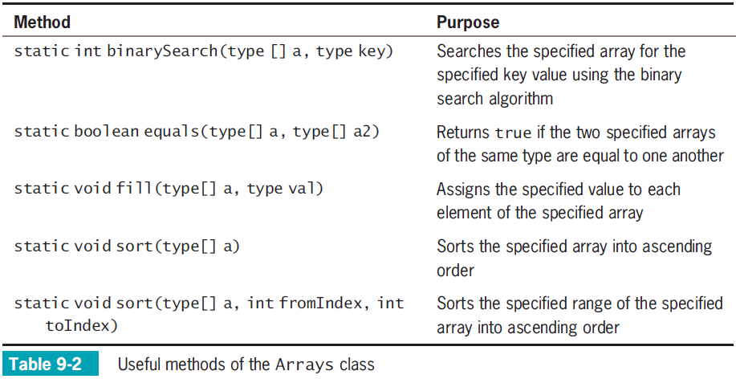
Using the Arrays Class (cont’d.)
Java Programming, Seventh Edition

Slide 20
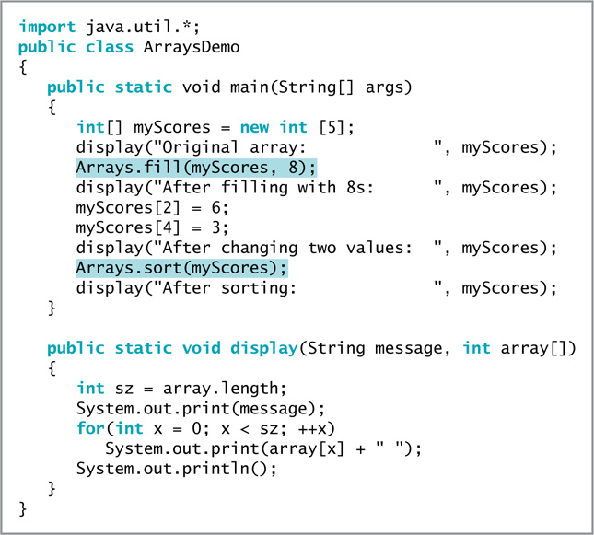
Figure 9-15 The ArraysDemo application
Java Programming, Seventh Edition

Slide 21
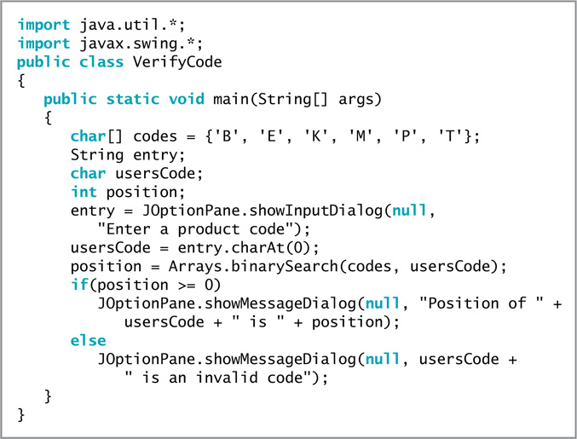
Figure 9-17 The VerifyCode application
Java Programming, Seventh Edition

Slide 22
Using the ArrayList Class
The ArrayList class provides some advantages over the Arrays class
  Dynamically resizable
  Can add an item at any point in an ArrayList container
  Can remove an item at any point in an ArrayList container
Capacity
  The number of items an ArrayList can hold without having to increase its size
Java Programming, Seventh Edition

Slide 23
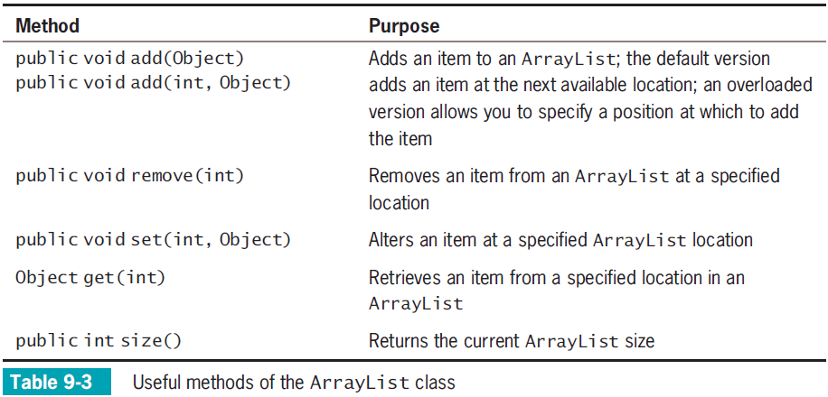
Using the ArrayList Class (cont’d.)
Java Programming, Seventh Edition

Slide 24
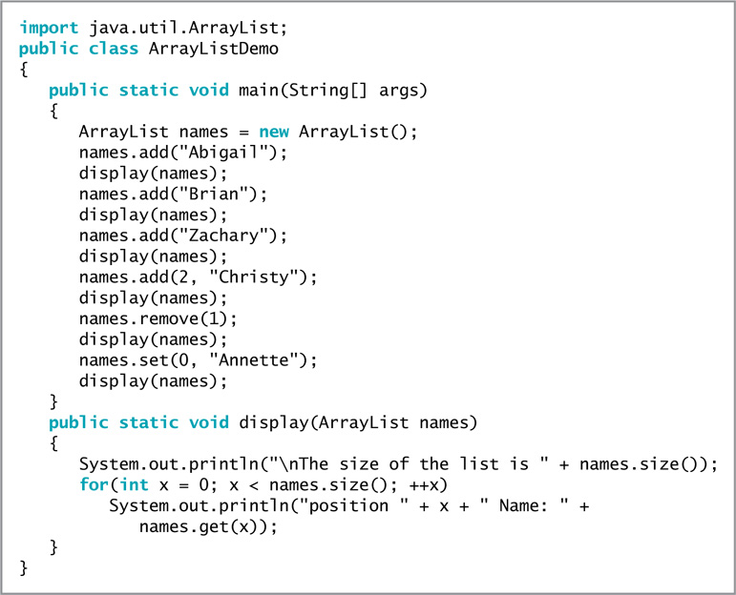
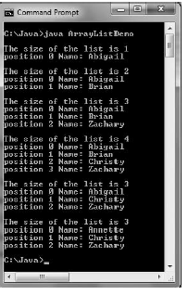
Using the ArrayList Class (cont’d.)
Figure 9-20 The ArrayListDemo program
Java Programming, Seventh Edition

Slide 25
Understanding the Limitations of the ArrayList Class
You cannot use an ArrayList to store primitive types
You must cast elements to the appropriate reference type, or you must declare a reference type in the ArrayList declaration
Java Programming, Seventh Edition

Slide 26
Creating Enumerations
Enumerated data type
  A programmer-created data type with a fixed set of values
To create an enumerated data type, use:
  The keyword enum
  An identifier for the type
  A pair of curly braces that contain a list of the enum constants
    enum Month {JAN, FEB, MAR, APR, MAY, JUN,
    JUL, AUG, SEP, OCT, NOV, DEC};
Java Programming, Seventh Edition

Slide 27
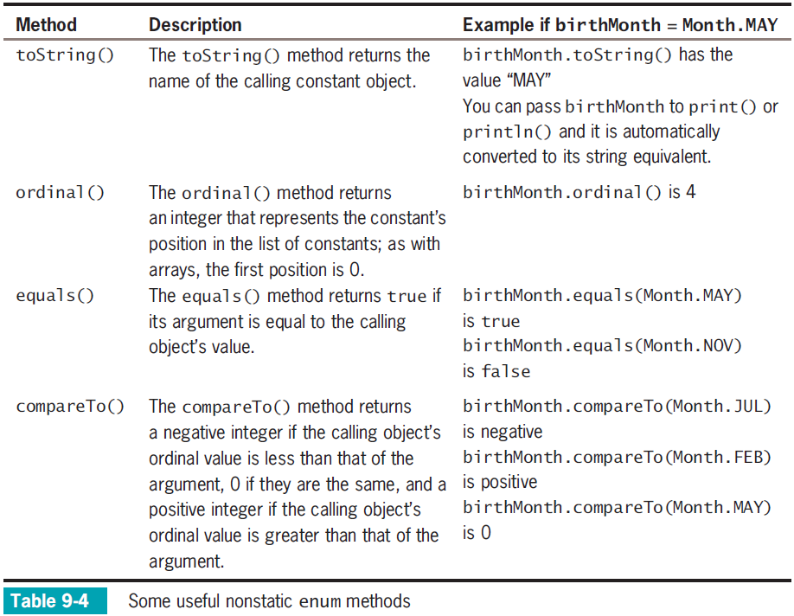
Java Programming, Seventh Edition

Slide 28
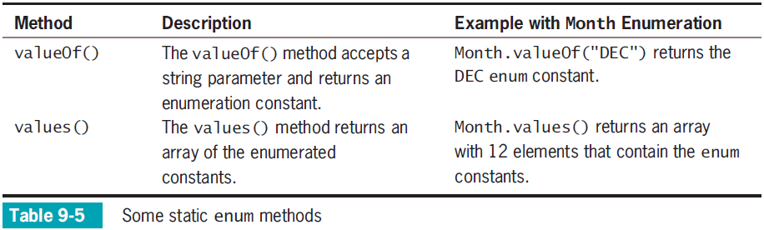
Creating Enumerations (cont’d.)
Java Programming, Seventh Edition

Slide 29
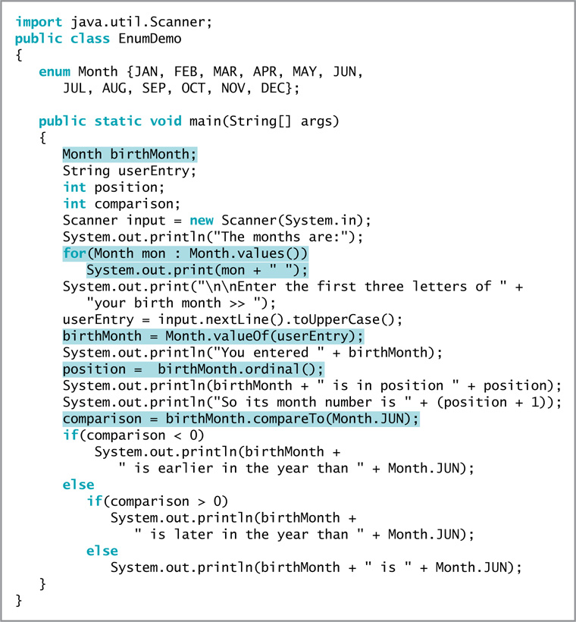
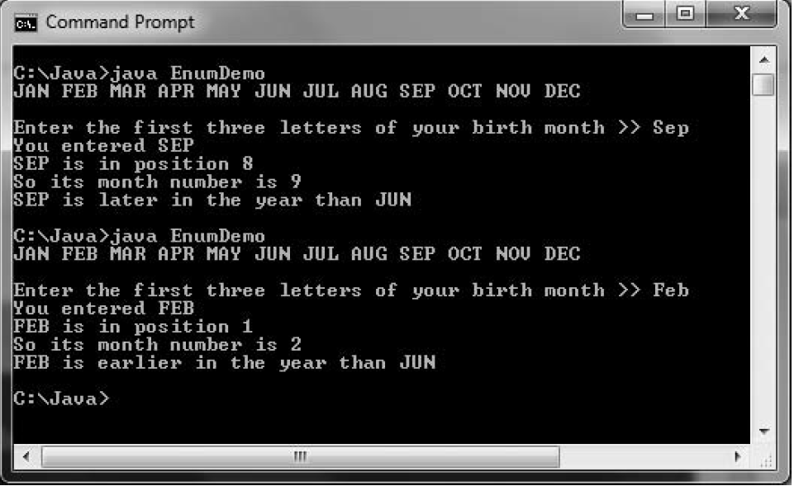
Figure 9-24 The EnumDemo class
Java Programming, Seventh Edition

Slide 30
Creating Enumerations (cont’d.)
You can declare an enumerated type in its own file
  Filename matches the type name and has a .java extension
Starting with Java 7, you can use comparison operators with enumeration constants
You can use enumerations to control a switch structure
Java Programming, Seventh Edition

Slide 31
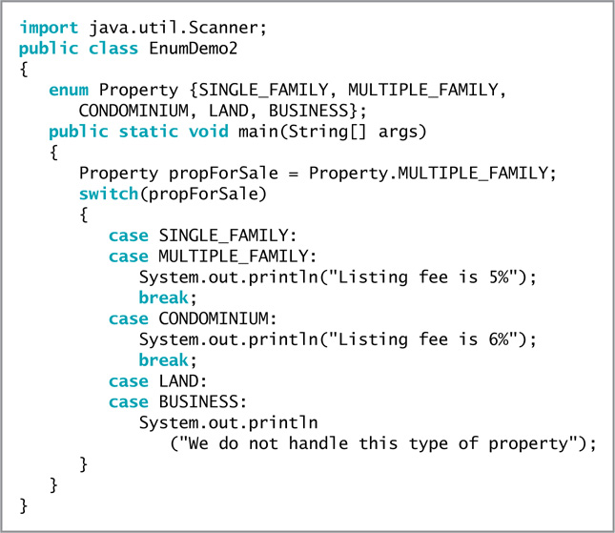
Figure 9-26 The EnumDemo2 class
Java Programming, Seventh Edition

Slide 32
Creating Enumerations (cont’d.)
Advantages of creating an enumeration type:
  Only allowed values can be assigned
  Using enums makes the values type-safe
  Provides a form of self-documentation
  You can also add methods and other fields to an enum type
Type-safe
  Describes a data type for which only appropriate behaviors are allowed
Java Programming, Seventh Edition

Slide 33
You Do It
Using a Bubble Sort
Using an Insertion Sort
Using a Two-Dimensional Array
Using Arrays Class Methods
Creating Enumerations
Java Programming, Seventh Edition

Slide 34
Don’t Do It
Don’t forget that the first subscript used with a two-dimensional array represents the row, and that the second subscript represents the column
Don’t try to store primitive data types in an ArrayList structure
Don’t think enum constants are strings; they are not enclosed in quotes
Java Programming, Seventh Edition

Slide 35
Summary
Sorting
  The process of arranging a series of objects in some logical order
Two-dimensional arrays
  Both rows and columns
Arrays class
ArrayList class
A programmer-created data type with a fixed set of values is an enumerated data type
Java Programming, Seventh Edition

Slide 36


Java Programming, Seventh Edition

